Slide 1
JavaScript
Creating a Programmable Web Page

Slide 2
Tutorial Objectives
Understand basic JavaScript syntax
Create an embedded and external script
Work with variables and data
Work with data objects and extract values from dates
Work with expressions and operators
Create and call a JavaScript function
Work with arrays and conditional statements
Learn about program loops

Slide 3
Server-Side Programs
a user must be connected to the Web server to run the server-side script
only the programmer can create or alter the script
the system administrator has to be concerned about users continually accessing the server and potentially overloading the system

Slide 4
Client-Side Programs
solve many of the problems associated with server-side scripts
can be tested locally without first uploading it to a Web server
are likely to be more responsive to the user
can never completely replace server-side scripts

Slide 5
Introduction to JavaScript
JavaScript is an interpreted programming or script language from Netscape.
JavaScript is used in Web site development to such things as:
      automatically change a formatted date on a Web page
      cause a linked-to-page to appear in a popup window
      cause text or a graphic image to change during a mouse rollover

Slide 6
Java vs. JavaScript
Requires the JDK to create the applet
Requires a Java virtual machine to run the applet
Applet files are distinct from the XHTML code
Source code is hidden from the user
Programs must be saved as separate files and compiled before they can be run
Programs run on the server side
Requires a text editor
Required a browser that can interpret JavaScript code
JavaScript can be placed within HTML and XHTML
Source code is made accessible to the user
Programs cannot write content to the hard disk
Programs run on the client side

Slide 7
ECMAScript
The responsibility for the development of a scripting standard has been transferred to an international body called the European Computer Manufacturers Association (ECMA).
The standard developed by the ECMA is called ECMAScript, though browsers still refer to it as JavaScript.
The latest version is ECMA-262, which is supported by the major browsers.

Slide 8
Other Client-side Languages
Internet Explorer supports JScript.
JScript is identical to JavaScript, but there are some JavaScript commands not supported in JScript, and vice versa.
Other client-side programming languages are also available to Web page designers, such as the Internet Explorer scripting language, VBScript.

Slide 9
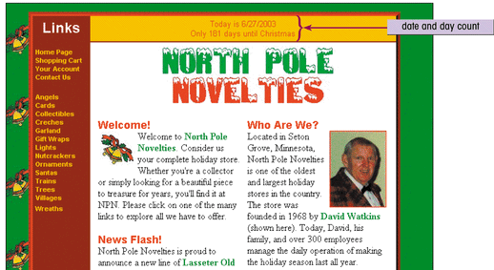
Example of Web Site using JavaScript

Slide 10
Writing a JavaScript Program
The Web browser runs a JavaScript program when the Web page is first loaded, or in response to an event.
JavaScript programs can either be placed directly into the HTML file or they can be saved in external files.
  placing a program in an external file allows you to hide the program code from the user
  source code placed directly in the HTML file can be viewed by anyone

Slide 11
Writing a JavaScript Program
A JavaScript program can be placed anywhere within the HTML file.
Many programmers favor placing their programs between <head> tags in order to separate the programming code from the Web page content and layout.
Some programmers prefer placing programs within the body of the Web page at the location where the program output is generated and displayed.

Slide 12
Using the <script> Tag
To embed a client-side script in a Web page, use the element:
<script type=“text/javascript” >
script commands and comments
</script>
To access an external script, use:
<script src=“url” type=“text/javascript”>
script commands and comments
</script>

Slide 13
Comments
The syntax for a single-line comment is:
// comment text
The syntax of a multi-line comment is:
/*
comment text covering several lines
*/

Slide 14
Hiding Script from Older Browsers
You can hide the script from these browsers using comment tags:
  <script type=“text/javascript”>
  <!-- Hide from non-JavaScript browsers
  JavaScript commands
  // Stop hiding from older browsers -->
  </script>
When a Web browser that doesn’t support scripts encounters this code, it ignores the <script> tag.

Slide 15
Writing Output to a Web Page
JavaScript provides two methods to write text to a Web page:
  document.write(“text”);
  document.writeln(“text”);
The document.writeln() method differs from document.write() in that it attaches a carriage return to the end of each text string sent to the Web page.
document.write("<h3>News Flash!</h3><br />");

Slide 16
JavaScript Syntax Issues
JavaScript commands and names are case-sensitive.
JavaScript command lines end with a semicolon to separate it from the next command line in the program.
  in some situations, the semicolon is optional
  semicolons are useful to make your code easier to follow and interpret

Slide 17
Working with Variables & Data
A variable is a named element in a program that stores information. The following restrictions apply to variable names:
  the first character must be either a letter or an underscore character ( _ )
  the remaining characters can be letters, numbers, or underscore characters
  variable names cannot contain spaces
Variable names are case-sensitive.
document.write(Year);

Slide 18
Types of Variables
JavaScript supports four different types of variables:
  numeric variables can be a number, such as 13, 22.5, or -3.14159
  string variables is any group of characters, such as “Hello” or “Happy Holidays!”
  Boolean variables are variables that accept one of two values, either true or false
  null variables is a variable that has no value at all

Slide 19
Declaring a Variable
Before you can use a variable in your program, you need to declare a variable using the var command or by assigning the variable a value.
Any of the following commands is a legitimate way of creating a variable named “Month”:
  var Month;
  var Month = “December”;
  Month = “December”;

Slide 20
Working with Dates
There are two ways to create a date object:
variable = new Date(“month day, year, hours:minutes: seconds”)
variable = new Date(year, month, day, hours, minutes, seconds”)
  variable is the name of the variable that contains the date information
  month, day, year, hours, minutes, and seconds indicate the date and time
var Today=new Date(“October 15, 2006”);
var Today=new Date(2006, 9, 15);

Slide 21
Retrieving the Day & Time Values
JavaScript stores dates and times as the number of milliseconds since 6 p.m on 12/31/69.
Use built in JavaScript date methods to do calculations.
If you want the ThisDay variable to store the day of the month. To get that information, apply the getDate() method.
DayValue = DateObject.getDate()

Slide 22
Retrieving the Month Value
The getMonth() method extracts the value of the current month.
JavaScript starts counting months with 0 for January, you may want to add 1 to the month number returned by the getMonth() method.
ThisMonth = Today.getMonth()+1;

Slide 23
Retrieving the Year Value
The getFullYear() method extracts the year value from the date variable.
ThisYear = Today.getFullYear();

Slide 24
Working with Expressions and Operators
Expressions are JavaScript commands that assign values to variables.
Expressions are created using variables, values, and operators.
The + operator performs the action of adding or combining two elements. For example,
  var ThisMonth = Today.getMonth()+1;

Slide 25
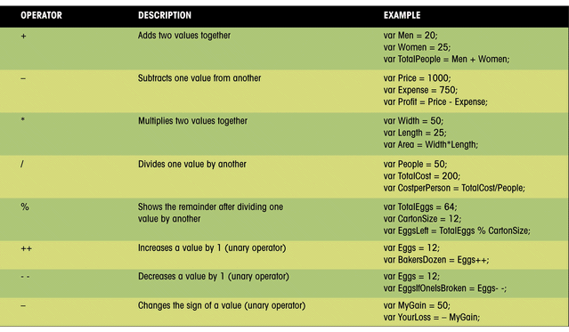

Slide 26
Operators
Binary operators work on two elements in an expression.
Unary operators work on only one variable.
  unary operators include: the increment (++), decrement (--), and negation (-) operators.
An increment operator is used to increase the value of the x variable by one.
  x = 100;
  y = x++;

Slide 27
Operators
The decrement operator reduces the value of a variable by 1.
  x = 100;
  y = x--;
The negation operator changes the sign of a variable:
  x = -100;
  y = -x;

Slide 28
Assignment Operators
Expressions assign values using assignment operators. “=” is the most common one.
Additional includes the += operator
The following create the same results:
  x = x + y;
  x += y
Either of the following increase the value of the x variable by 2:
x = x + 2;
x += 2

Slide 29
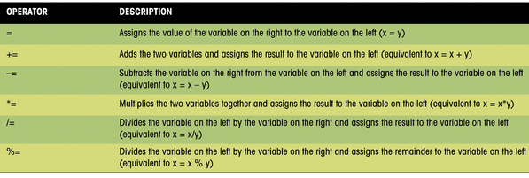
Assignment Operators

Slide 30
The Math Object & Math Methods
Another way of performing a calculation is to use the JavaScript built-in Math methods.
These methods are applied to an object called the Math object.
The syntax for applying a Math method is:
  value = Math.method(variable);
For example,
AbsValue = Math.abs(NumVar);

Slide 31
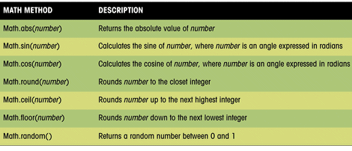

Slide 32
Creating JavaScript Functions
function function_name(parameters) {
  JavaScript commands
  }
  parameters are the values sent to the function (note: not all functions require parameters)
  { and } are used to mark the beginning and end of the commands in the function.

Slide 33
Creating JavaScript Functions
Function names are case-sensitive.
The function name must begin with a letter or underscore ( _ ) and cannot contain any spaces.
There is no limit to the number of function parameters that a function may contain.
The parameters must be placed within parentheses, following the function name, and the parameters must be separated by commas.

Slide 34
Performing an Action with a Function
The following function displays a message with the current date:
  function ShowDate(date) {
  document.write(“Today is” + date + “<br>”);
  }
  there is one line in the function’s command block, which displays the current date along with a text string

Slide 35
Performing an Action with a Function
To call the ShowDate function, enter:
      var Today = “3/9/2006”;
      ShowDate(Today);
  the first command creates a variable named “Today” and assigns it the text string, “3/9/2006”
  the second command runs the ShowDate function, using the value of the Today variable as a parameter
  result is “Today is 3/9/2006”

Slide 36
Returning a Value from a Function
To use a function to calculate a value use the return command along with a variable or value.
  function Area(Width, Length) {
  var Size = Width*Length;
  return Size;
  }
  the Area function calculates the area of a rectangular region and places the value in a variable named “Size”
  the value of the Size variable is returned by the function

Slide 37
Placing a Function in an HTML File
The function definition must be placed before the command that calls the function.
One convention is to place all of the function definitions in the <head> section.
A function is executed only when called by another JavaScript command.
It’s common practice for JavaScript programmers to create libraries of functions located in external files.

Slide 38
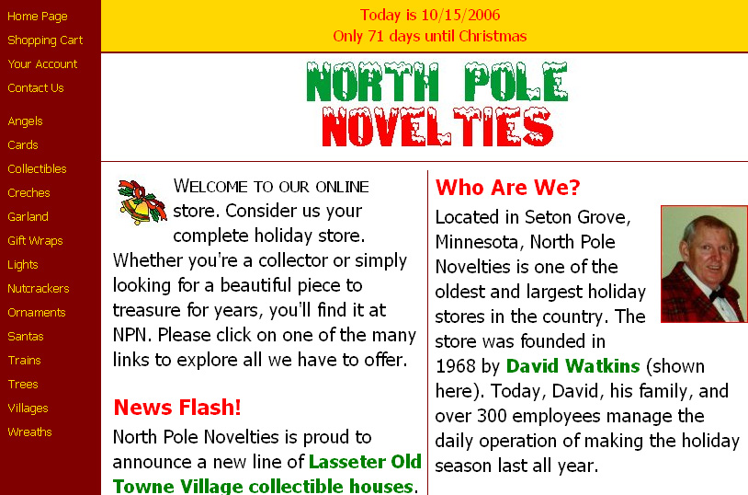
document.write("Today is "+ThisMonth+"/"+ ThisDay+"/"+ThisYear+"<br />");
document.write("Only "+DaysLeft+
" days until Christmas");

Slide 39
<head>
<script src="library.js" type="text/javascript"> </script>
</head>
<script type="text/javascript">
var Today=new Date("October 15, 2006");
var ThisDay=Today.getDate();
var ThisMonth=Today.getMonth()+1;
var ThisYear=Today.getFullYear();
var DaysLeft=XmasDays(Today);
</script>
document.write("Today is "+ThisMonth+"/"+ ThisDay+"/"+ThisYear+"<br />");
document.write("Only "+DaysLeft+
" days until Christmas");

Slide 40
library.js
function XmasDays(CheckDay) {
var XYear=CheckDay.getFullYear();
var XDay=new Date("December, 25, 2006");
XDay.setFullYear(XYear);
var DayCount=(XDay-CheckDay) /(1000*60*60*24);
DayCount=Math.round(DayCount);
return DayCount;
}

Slide 41
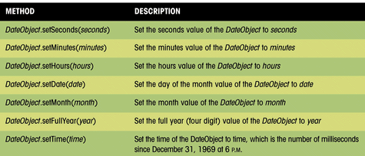
Setting Date Values
JavaScript functions that allow
you to set or change the values of date objects

Slide 42
Working with Conditional Statements
if (condition) {
  JavaScript Commands
  }
  condition is an expression that is either true or false
  if the condition is true, the JavaScript Commands in the command block are executed
  if the condition is not true, then no action is taken

Slide 43
Comparison, Logical, and
Conditional Operators
To create a condition, you need one of three types of operators:
  a comparison operator compares the value of one element with that of another, which creates a Boolean expression that is either true or false
  a logical operator connects two or more Boolean expressions
  a conditional operator tests whether a specific condition is true and returns one value if the condition is true and a different value if the condition is false

Slide 44
An Example of
Boolean Expressions
x < 100;
  if x is less than 100, this expression returns the value true; however, if x is 100 or greater, the expression is false
y == 20;
  the y variable must have an exact value of 20 for the expression to be true
  comparison operator uses a double equal sign (==)

Slide 45
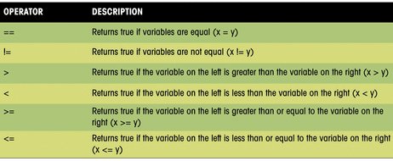
Comparison Operators

Slide 46
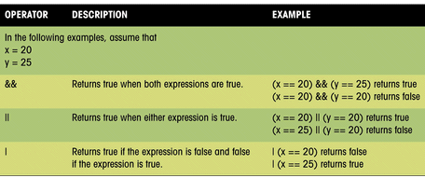
A Logical Operator
The logical operator && returns a value of true only if all of the Boolean expressions are true.

Slide 47
A Conditional Operator
tests whether a specific condition is true and returns one value if the condition is true and a different value if the condition is false.
  Message = (mail == “Yes”) ? “You have mail”: “No mail”;
  tests whether the mail variable is equal to the value “Yes”
    if it is, the Message variable has the value “You have mail”;
    otherwise, the Message variable has the value “No mail”.

Slide 48
Using an If...Else Statement
if (condition) {
  JavaScript Commands if true
  } else
  JavaScript Commands if false
  }
  condition is an expression that is either true or false, and one set of commands is run if the expression is true, and another is run if the expression is false

Slide 49
if...else Conditional Statement
document.write("Today is " + ThisMonth +
"/“+ThisDay+"/"+ThisYear+"<br />");
if (DaysLeft > 0) {
document.write("Only "+DaysLeft+
" days until Christmas");
} else {
document.write("Happy Holidays from
Nroth Pole Novelties");
}

Slide 50
Using Arrays
An array is an ordered collection of values referenced by a single variable name.
The syntax for creating an array variable is:
  var variable = new Array(size);
  variable is the name of the array variable
  size is the number of elements in the array (optional)
To populate the array with values, use:
variable[i]=value;
where i is the i^{th} item of the array. The 1st item has an index value of 0.

Slide 51
Using Arrays
To create and populate the array in a single statement, use:
  var variable = new Array(values);
  values are the array elements enclosed in quotes and separated by commas
  var MonthTxt=new Array(“”, “January”, “February”, “March”, “April”, “May”, “June”, “July”, “August”, “September”, “October”, “November”, “December”);
    January will have an index value of “1”.

Slide 52
<script type="text/javascript">
var Today=new Date();
var ThisDay=Today.getDate();
var ThisMonth=Today.getMonth()+1;
var ThisYear=Today.getFullYear();
var DaysLeft=XmasDays(Today);
var MonthTxt = new Array("", "January", "February", "March",
"April", "May", "June", "July", "August", "September",
"October","November", "December");
document.write("Today is "+MonthTxt[ThisMonth]+" " +
ThisDay+", "+ThisYear+"<br />");
if (DaysLeft > 0) {
document.write("Only "+DaysLeft+" days until Christmas");
} else {
document.write("Happy Holidays from North Pole
Novelties");
}
</script>

Slide 53
Creating the MonthText Function in library2.js
function MonthTxt(MonthNumber) {
var Month=new Array();
Month[0]="";
Month[1]="January";
Month[2]="February";
Month[3]="March";
Month[4]="April";
Month[5]="May";
Month[6]="June";
Month[7]="July";
Month[8]="August";
Month[9]="September";
Month[10]="October";
Month[11]="November";
Month[12]="December";
return Month[MonthNumber];
}

Slide 54
Calling the MonthTxt Function
use the ThisMonth variable
to call the MonthTxt function
and then stores the result in
a new variable named “MonthName”
<head>
<script src="library2.js"
type="text/javascript"></script>
</head>
var MonthName=MonthTxt(ThisMonth);

Slide 55
Working with Program Loops
A program loop is a set of instructions that is executed repeatedly.
There are two types of loops:
  loops that repeat a set number of times before quitting
  loops that repeat as long as a certain condition is met

Slide 56
The For Loop
The For loop allows you to create a group of commands to be executed a set number of times through the use of a counter that tracks the number of times the command block has been run.
Set an initial value for the counter, and each time the command block is executed, the counter changes in value.
When the counter reaches a value above or below a certain stopping value, the loop ends.

Slide 57
The For Loop Continued
  for (start; condition; update) {
  JavaScript Commands
  }
  start is the starting value of the counter
  condition is a Boolean expression that must be true for the loop to continue
  update specifies how the counter changes in value each time the command block is executed

Slide 58
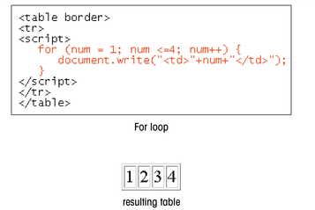

Slide 59
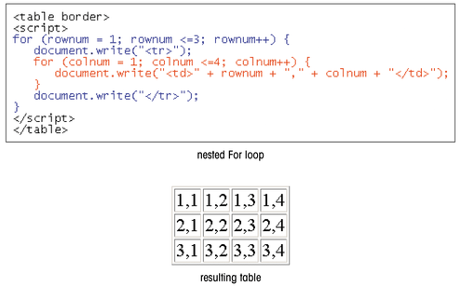

Slide 60
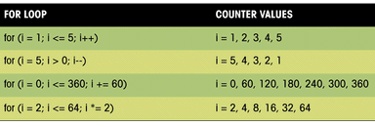
Specifying Counter Values in a For Loop

Slide 61
The While Loop
The While loop runs a command group as long as a specific condition is met, but it does not employ any counters.
The general syntax of the While loop is:
  while (condition) {
  JavaScript Commands
  }
  condition is a Boolean expression that can be either true or false

Slide 62
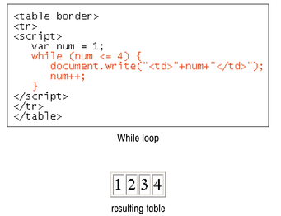

Slide 63
